Slide 1
Chair’s Report
2016-17

Slide 2
Disclosure of Relationships
No relationships with commercial entities
No potential for conflicts of interest within this presentation

Slide 3
Learning Objectives
Increase awareness of the DoM strategic priorities (guiding principles)
Highlight key initiatives (want to get involved?)
Celebrate achievements
Review goals for the upcoming year
http://www.deptmedicine.utoronto.ca/events → click on “Events Photo Gallery”

Slide 4
VISION
We meaningfully impact health through international leadership in education, research and the translation of new knowledge into better care and health outcomes.

Slide 5
STRATEGIC PRIORITIES 2015-18 Guiding Principles
Patients first
Equity, diversity & professionalism
Social accountability
Training to meet population needs
Generation & translation of new knowledge to impact health
Inclusiveness (all our faculty members, inter-professional colleagues, hospital & university identities)
Mentorship across the academic lifespan
Fundraising to achieve our goals

Slide 6
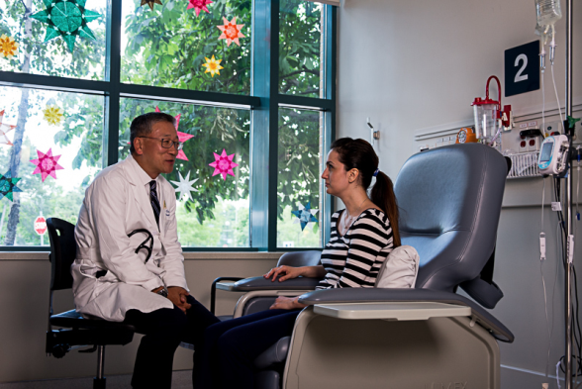
Patients first (patient care, education, research, QI)
Strategic Priority 1

Slide 7
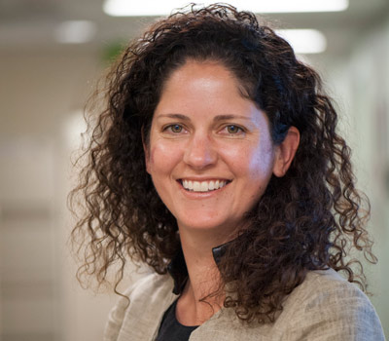
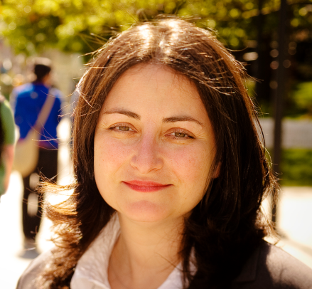
Education in Person-Centered Care (PCC)
Retreat on PCC – broad input
Co-leads appointed to design, implement & oversee educational activities in PCC throughout UG & PG Medicine
Learning experiences
E.g. Indigenous peoples
Assessment & evaluation strategies
Faculty development
Lisa Richardson & Ayelet Kuper
Co-leads Education in PCC

Slide 8
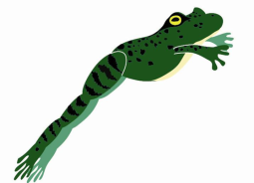
Computational Medicine Initiative Partnership of Departments of Medicine & Computer Science
Our approach to managing chronic disease has to change
Proactive not reactive
Recognize the important role of patient self-management
Rise of big data, computational medicine and mobile technology offers hope
Mobile devices crucial links between patients and their caregivers, providers & peers, but patient data remains fragmented
EHRs do not provide real-time data to facilitate clinical decision-making
Patient- generated health data remains outside the system
We want to overcome these systemic barriers

Slide 9
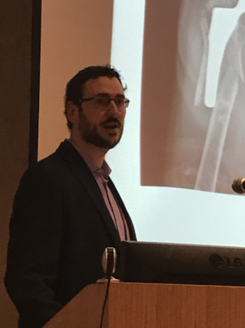
Computational Medicine Initiative
Kaveh Shojania, Sacha Bhatia & Trevor Jamieson and colleagues
THE VISION:
To create a patient-centered data network where patients own their own data and seamlessly connect to providers / institutions and take control of their own care
Trevor Jamieson, Director of Virtual Care, Women’s College Institute for Health System Solutions & Virtual Care (WIHV) & GIM SMH – Speaking at Tel Aviv University

Slide 10
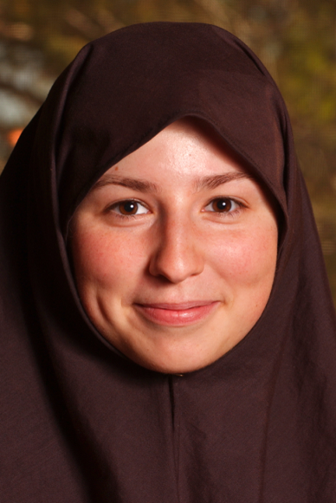
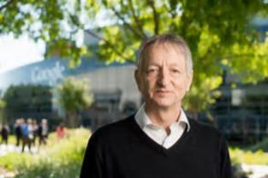
Computational Medicine Initiative
Co-recruitment with Dept Computer Science & Vector Institute of Marzyeh Ghassemi
PhD at the Computer Science & Artificial Intelligence Laboratory, Massachusetts Institute of Technology
Currently one-year post-doc at Google
Geoff Hinton
Chief Scientific Advisor, Vector Institute

Slide 11
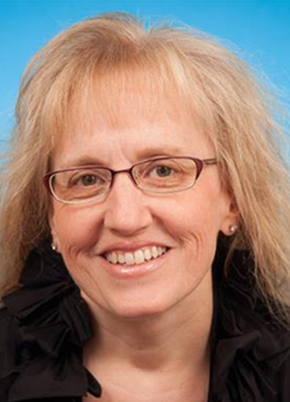
equity, diversity and professionalism
Sharon Straus
Vice-Chair, Mentorship,
Equity & Diversity
Strategic priority 2

Slide 12
Low-Hanging Fruit: Sex/Gender Faculty Recruits 2000-2015 by Sex & Position Description
50% 43% 39% 33% % female

Slide 13
Understanding the Culture
Perceptions and experiences of a gender gap at a Canadian research institute and potential strategies to mitigate this gap: a sequential mixed-methods study. Mascarenhas A, Moore JE, Tricco AC, Hamid J, Daly C, Bain J, Jassemi S, Kiran T, Baxter N, Straus SE. CMAJ Open. 2017
Strategies to Prevent or Reduce Gender Bias in Peer Review of Research Grants: A Rapid Scoping Review. Tricco AC, Thomas SM, Antony J, Rios P, Robson R, Pattani R, Ghassemi M, Sullivan S, Selvaratnam I, Tannenbaum C, Straus SE. PLoS One. 2017

Slide 14
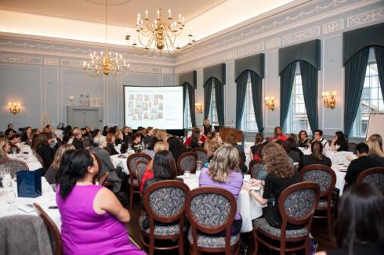
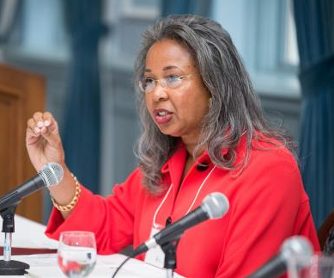
Summit for Women in Academic Medicine (WAM)

Slide 15
Promote Equity & Diversity
2015-16 Voice of the Resident Survey
39% experienced discrimination or harassment in prior academic year
Especially Muslim & Middle Eastern residents, esp. females; female residents who are parents
2017 Faculty Survey
Please complete the questionnaire!
Reena Pattani & Karen Burns
Co-Leads 2017 Faculty Survey

Slide 16
Indigenous Peoples
Report of Steering Committee, U of T Response to Truth and Reconciliation Commission of Canada
Established Faculty of Medicine’s Office of Indigenous Medical Education
Goals:
↑ number of Indigenous health professionals
↑ cultural competency of our MD trainees re Indigenous peoples
Lisa Richardson Curricular Co-Lead

Slide 17
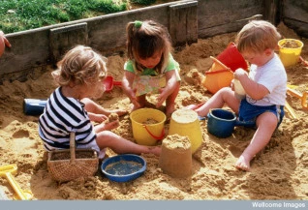
Promote Professionalism
Understanding the culture
Prevention and management of unprofessional behaviour:
a scoping review AC. Tricco, P. Rios, W. Zarin, …SE. Straus Under Review
2017 Faculty Survey
Promoting citizenship (CFAR, senior promotion)
Research integrity task force

Slide 18
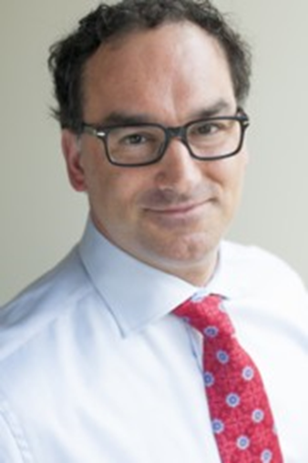
Social accountability & resource stewardship
Kaveh Shojania
Vice-Chair, Quality & Innovation
Strategic Priority 3

Slide 19
Full Time Faculty Recruited (2006-2017)
N=43
100% success at CFAR (n=15) & senior promotion (n=11)

Slide 20
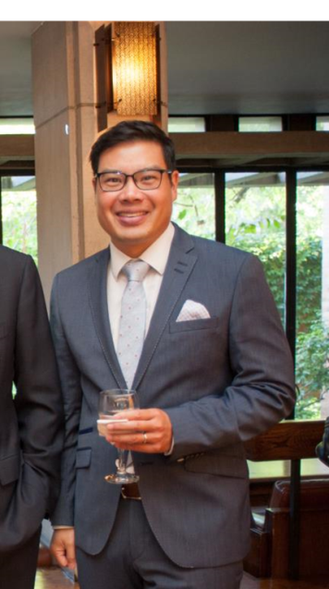
Co-Learning Curriculum in QI
Faculty & residents learn QI skills together
Pilot 2011-12 in three subspecialties
~ 35 subspecialties in 2017 across six
departments + Western U - McMaster and Virginia Tech coming
~ 20 faculty graduates now teaching
Enormous success of the annual QI day
Brian Wong
Director

Slide 21
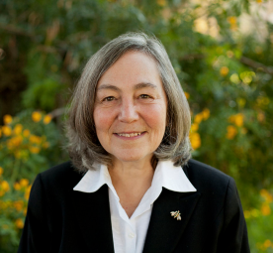
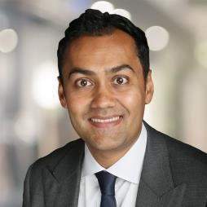
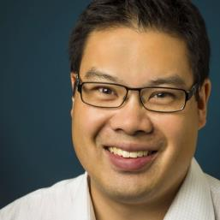
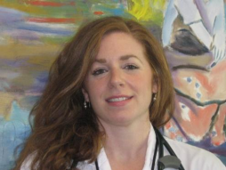
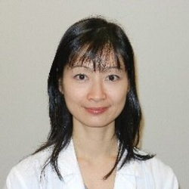
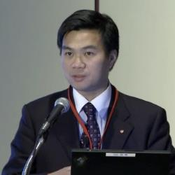
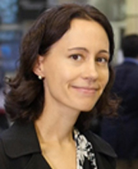
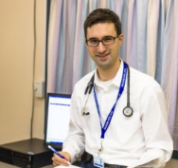
Leadership in Choosing Wisely
National Clinical Leaders:
Christine Soong, Lisa Hicks, Michelle Sholzberg, Jerome Leis, Chi-Ming Chow
Dr. Wendy Levinson, Chair, Choosing Wisely Canada & International Choosing Wisely Consortium, Sacha Bhatia, Evaluation Lead, and Brian Wong, Education Lead
CBC Radio last weekend!

Slide 22
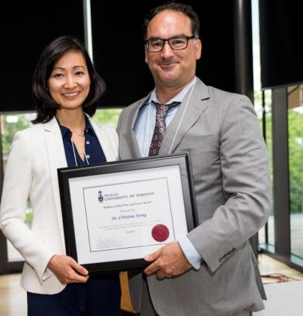
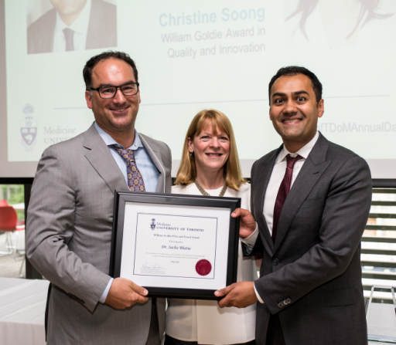
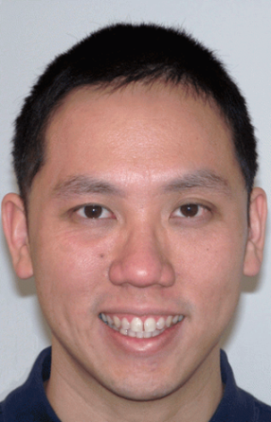
2017 Awards for Quality & Innovation
Christine Soong & Sacha Bhatia
William Goldie Award in Quality and Innovation
Geoffrey Nguyen
Senior Faculty Award for
Quality and Innovation

Slide 23
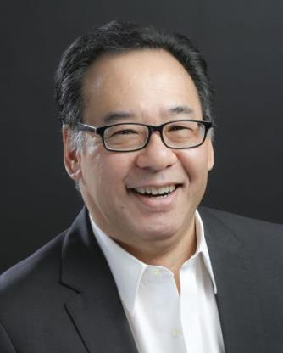
Align physician training to meet population needs
Dr. Arno Kumagai
Vice Chair, Education
Strategic Priority 4

Slide 24
Department of Medicine Educational Footprint
~ 1,000 postgraduate trainees (core residents, sub-specialty residents, clinical fellows)
We train ~ 1:2 Ontario’s & 1:3 Canada’s internal medicine specialists
> 350 fellowships (~ 450 post residency trainees)

Slide 25
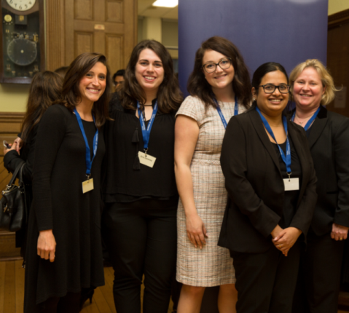
New Educational Leaders Formal Search Process (Posting, Interviews)
New Directors:
PGME: Eric Yu
MD Program: Luke Devine
New Program Directors:
Core Medicine: Jeannette Goguen
Endo: Jeremy Gilbert
Emergency Medicine: Nazanin Meshkat
Med Onc: Raymond Jang
Palliative Med: James Downar
Nephrology: Jeff Schiff
Rheumatology: Dana Jerome
Clinical Immunology & Allergy: Christine Song

Slide 26
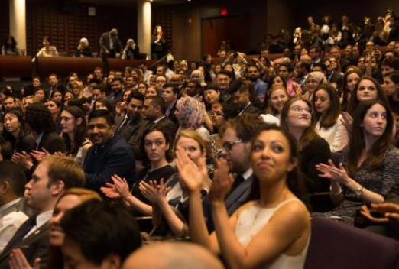
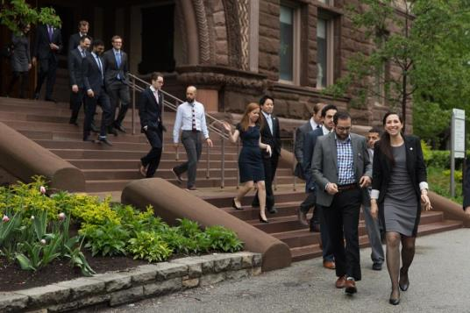
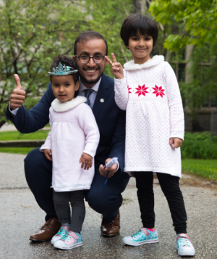
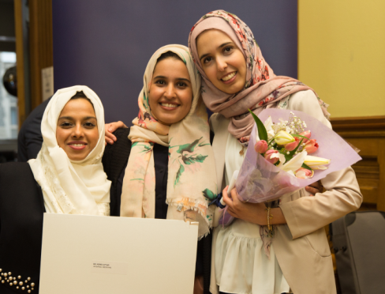
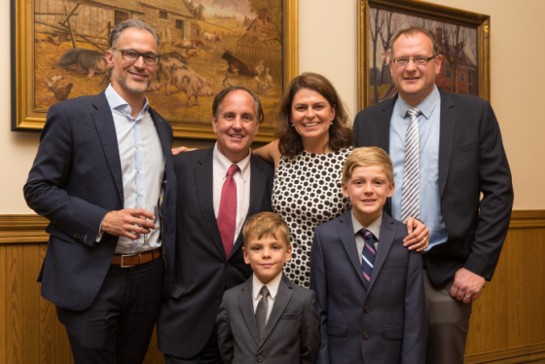
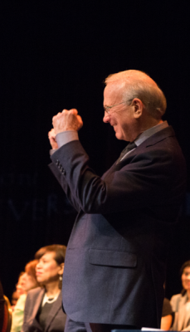
2017 Graduation (Residents/Fellows)

Slide 27
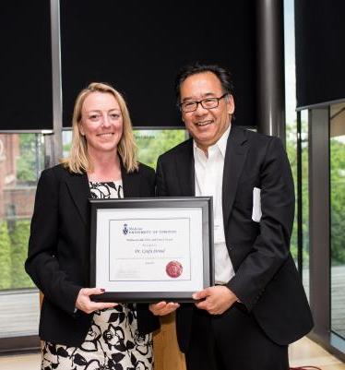
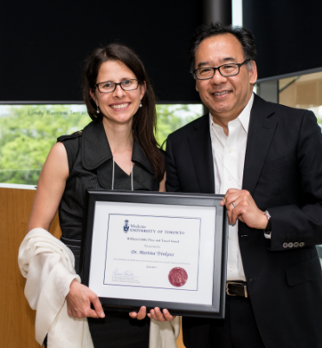
2017 DoM Education Awards
Heather Ross
Teacher of the Year
Lynfa Stroud & Martina Trinkaus
William Goldie Award in Education

Slide 28
Training for the Future
Competency-based education (CBE)
Increase trainee exposure to integrated models of primary-specialist care & ambulatory care
Advance use of new technologies in patient care

Slide 29
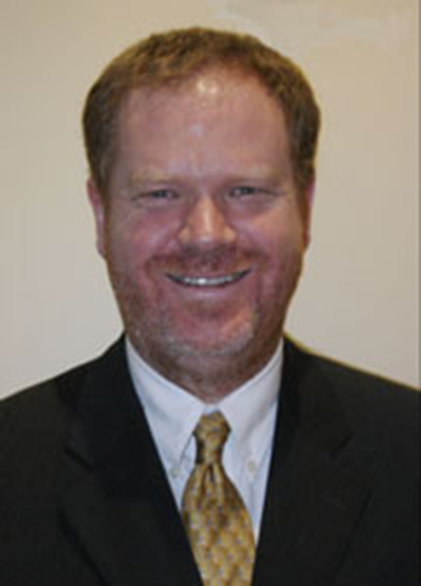
CBE: We’re in good hands
To be successful, CBE requires
Time
Simplicity (assessment)
Faculty & trainee buy-in
Can’t be perfect from the start
Dr. Scott Berry
Director CBE

Slide 30
Fellowships in DoM
Vital to our mission & vision
Feedback from fellows:
Lack of clarity re:
Fellowship objectives
Expectations re clinical work, on-call, protected time, teaching
Funding / remuneration
Insufficient orientation to the Canadian healthcare system
High number of DoM website ‘hits’

Slide 31
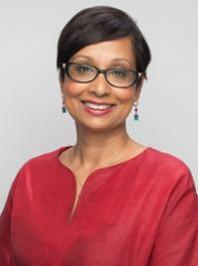
Fellowships
New Standards for Fellowships in DoM
Dr. Cheryl Jaigobin
Director, Fellowships

Slide 32
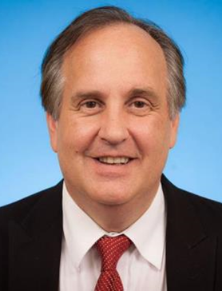
generation & translation of new knowledge to impact health
Michael Farkouh
Vice-Chair, Research
Strategic Priority 5

Slide 33
Notes:
ONE DoM & training program across 6 fully-affiliated teaching hospitals

Slide 34
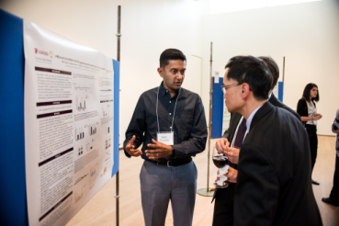
Toronto DoM RESEARCH Advantage
$176 million total funding (2016-17)
15 Canada Research Chairs (three new chairs)
2,202 research awards (2016-17)
135+ Clinician Scientist / Educator trainees
Affiliated with 16 interdisciplinary centers / scientific institutes @ UofT (we lead several)
Success at attracting best & brightest (Juni, Piquet, Montalban, many others…)

Slide 35
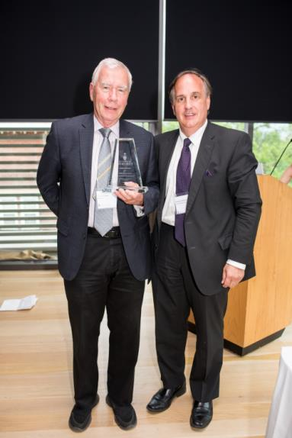
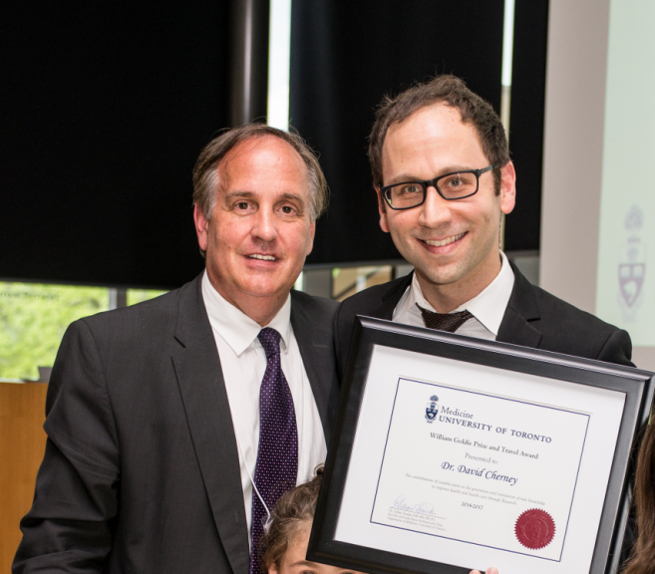
2017 DoM Research Awardees
Dan Cattran
Eaton Research Scholar
David Cherney, Goldie Research Award

Slide 36
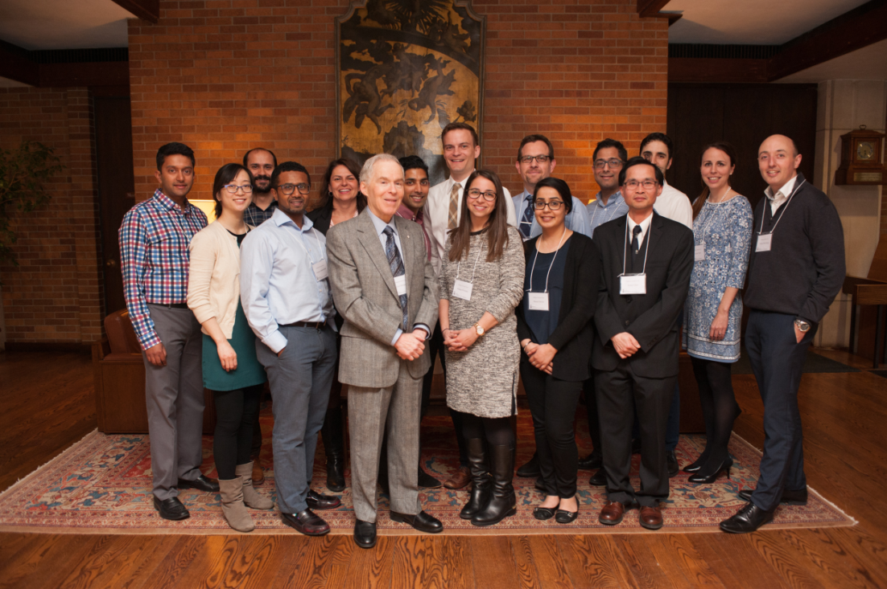
Inaugural Phillipson Scholars Event
Branding and business case

Slide 37
DoM ‘Network of Networks’
Building on the highly successful Challenge Grants to implement a transformational model of interdisciplinary, university-wide collaboration – a network of networks focused on themes with high public health impact
Anti-microbial stewardship
Critical Care
Diabetes (Banting & Best Diabetes Centre / SPOR)
Educational Research
GEMINI (internal medicine)
Global Paramedics
HIV
Personalized Medicine (medical oncology)
Stroke

Slide 38
Recognize the contributions of all
Strategic Priority 6

Slide 39
Valuing All
Dean’s Project: Valuing the Clinician Teacher (A. Kumagai & A. Freeland, co-chairs)
Academy for Clinical Excellence (Ophyr Mourad)
Awards Committees
Celebrating success / milestones

Slide 40
National & International Awards for Contributions to their Fields
Claire Bombardier, Distinguished Clinician Scholar Award, American College of Rheumatology
Daniel Drucker, Rolf Luft Foundation Award for Diabetes and Endocrinology
Anthony Lang, Pan-American Section Leadership Award, International Parkinson / Movement Disorder Society
Herbert Ho Ping Kong, Achievement Award in Education, Federation of Chinese American & Chinese Canadian Medical Societies and Musgrave Gold Medal, Institute of Jamaica
Lawrence A. Leiter, Lifetime Achievement Award for Research Excellence, Canadian Diabetes Association and Robert Volpe Distinguished Service Award, Canadian Society of Endocrinology & Metabolism
Gary Levy, Distinguished Service Award, International Society of Liver Transplantation

Slide 41
Steven Narod, Adjunct Professorship, Medical University Of Vienna and Basser Global Prize for BRCA, Abramson Cancer Center, U Penn
Amit Oza, Presidential Medal, Society of Gynecologic Oncology of Canada
Linda Rabeneck, 2016 Berk/Fise Clinical Achievement Award, American College of Gastroenterology
Larry Robinson, Lifetime Achievement Award, American Association Neuromuscular & Electro-diagnostic Medicine
Frances A. Shepherd, ONCLIVE Giant of Cancer Care Award and Fellow, American Society of Clinical Oncology
Rob Silver, 2017 Clinical Teacher Award, Association of Faculties of Medicine of Canada
Art Slutsky, Distinguished Lecturer in Respiratory Sciences Award, CIHR
Mona Loutfy, Excellence in Research Award, Canadian Association for HIV Research / Canadian Foundation for AIDS Research
Sharon Straus, Inductee, College of Artists, Scholars and Scientists, Royal Society of Canada

Slide 42
Allison McGeer, 2016 Lifetime Achievement Award, Association of Medical Microbiology & Infectious Disease Canada
Robert Fowler, 2017 Teasdale-Corti Humanitarian Award, RCPSC
Margaret Herridge, Honorary Membership, European Society of Intensive Care Medicine
Wendy Levinson, Ronald Christie Award, Canadian Association of Professors of Medicine
Cathy Craven, Senior Scientist Award, Craig H Nielsen Foundation
Chi-Ming Chow, Distinguished Teacher Award, Canadian CV Society
Arno Kumagai, Professionalism Article Prize, ABIM Foundation
Nazia Selzner, Research Excellence Award, Canadian Society of Transplantation

Slide 43
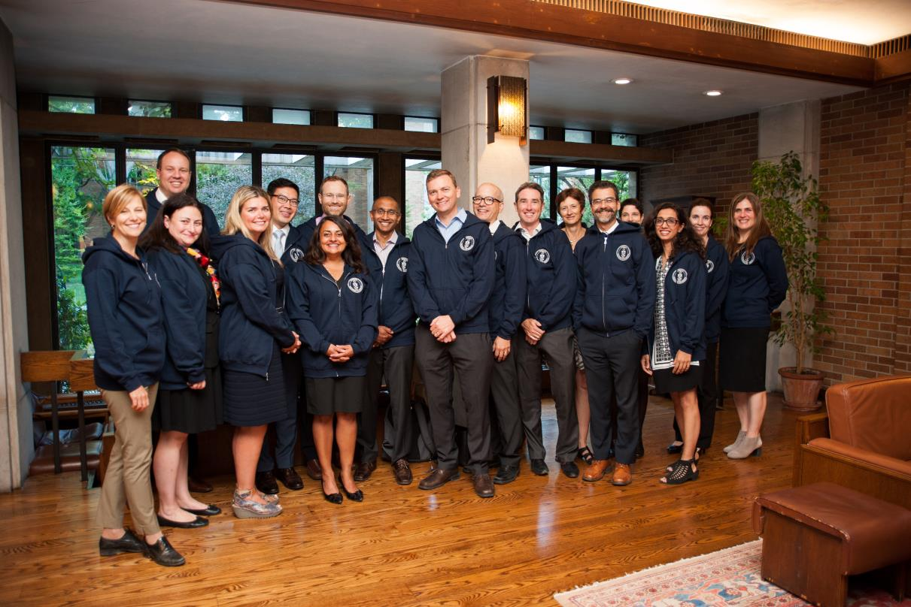
Inaugural Associate Professors Day

Slide 44
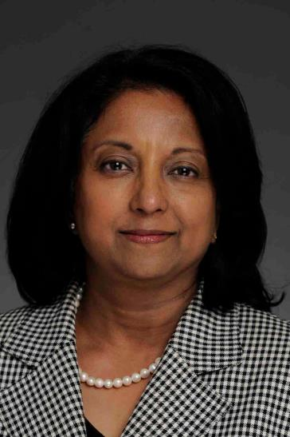
Senior Promotions 2016-17
Reviewed 43 candidates
40/43 (93%) recommended for promotion – 100% approved
28 to Assoc / 12 to Full Prof
THIS YEAR: candidates received a copy of the Chair’s Letter (with referee names removed)
Dr. Susan George
Chair, DoM Senior Promotions

Slide 45
Promotion Criteria (excellence) by Position description (n=40)
CPA most often used criterion for promotion (especially CT, CQI, CI)

Slide 46
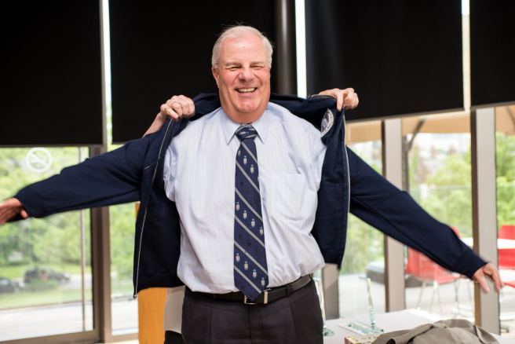
Career Transitions

Slide 47
Leadership transitions
CWMGR June 2017

Slide 48
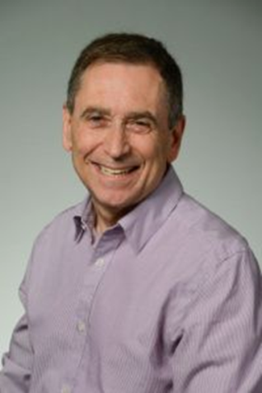
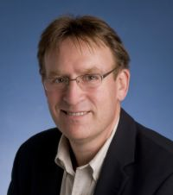
Kathy Pritchard
Department Division Director,
Medical Oncology
2011-2017
Neal Shear
Department Division Director,
Dermatology
2001 - 2017
Anthony Lang
Department Division Director,
Neurology
2004 - 2017
Gary Lewis
Department Division Director,
Endocrinology
2008 - 2017
Notes:
Dr. Pritchard's greatest strength is her ability to motivate and inspire her colleagues, co-workers and trainees to fulfill their greatest potential.
She is honest, fair and thoughtful.
Her leadership style builds consensus but she is not afraid to make a firm decision.
Dr. Pritchard is also very humble and has taught me the importance of treating everyone equally with the utmost respect irrespective of their stature or importance within the organization.
Kathy truly seems to put the good of others: patients, colleagues, the Division, first in all of her decision-making.
▪
Kathy is a natural leader. She's warm, genuinely caring and she has been highly effective in her role as DDD.
▪
I would say Dr. Pritchard's greatest strength as a leader is her ability to collaborate. She takes great interest in other people's ideas and finds ways to bring people together to work productively.
▪
Has a vision and can help others see and share that vision and gets things done (strategic plans)
integrates (different locations of the division of medical oncology; faculty with different job descriptions, different research interests)
kind - excellent role model and mentor for others; serious commitment to academic mission;
▪

Slide 49
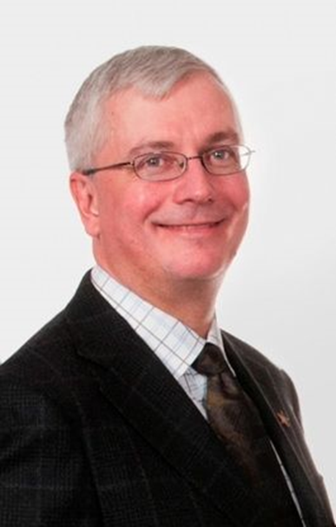
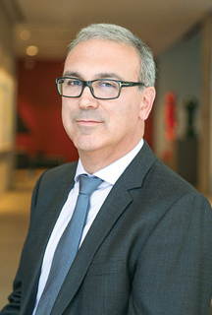
Danny Panisko
Director, Undergraduate Medical Education
2005 - 2017
Gary Newton
Physician in Chief of Medicine
Sinai Health System
2013-2015
Notes:
He has won several faculty-wide, hospital-wide, and academy-wide awards for excellence in Clinical Teaching including the Faculty Mary E. Hollington and W. T. Aikins Awards.
He is the Director of the Department of Medicine’s Master Teacher Program, which focuses on the faculty development of clinical teaching skills – the program won the inaugural Faculty-wide Helen P. Batty Faculty Development Award for Program Excellence in 2005.
Thoughtful, wise, humble. A tremendous mentor and role model. A consensus builder. His leadership reflects his personality.
Most recently, recipient of the Gladstone and Maisie Chang Chair in Teaching of Internal Medicine, University Health Network

Slide 50
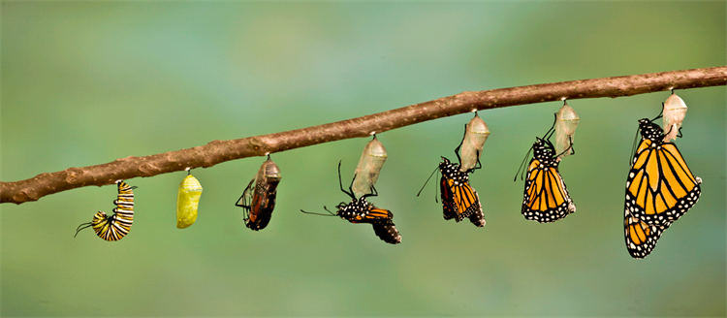
Enhance mentorship across the academic lifespan
Strategic Priority 7(1)

Slide 51
Mentorship Program (Sharon Straus)
Divisional mentorship facilitators
Faculty seminar series
Career transitions task force (Liesly Li)
Strategies to enable:
Faculty renewal through recruitment
Career development
Effective management of physician transitions in late career

Slide 52
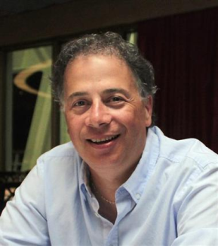
Continuing Faculty Appointment Review (CFAR)
Frank Silver & Joan Wither
Co-Chairs, CFAR Committee
Ongoing efforts to simplify process, enhance success, formative not evaluative
Opportunity for response and reconsideration rather than hard decision or appeal

Slide 53
Physician Wellness
PGY-2 Retreat (CMRs)
Shelly Dev
Keynote Speaker PGY-2 Retreat
UofTMed June 2017
Heal Thyself

Slide 54
Tuesday, May 2, 2017
Story Slams…celebrate storytelling.
130 people listened to 15 residents / faculty members recount how compassionate, empathetic care impacted not just their patient, but also themselves
Allan Detsky
Faculty Lead
Trainee Organizers: Wilson Kwong, Nilay Shah, Ariel Lefkowitz & Shaury Taran

Slide 55
Robert Hyland Mentorship Award
Mary Bell
Robert Hyland Award for
Excellence in Mentorship

Slide 56
Stewardship & fund-raising to achieve goals
Charles Chan
Senior Advisor, Finance
Clare Mitchell
Director of Business & Administration
Chris Adamson
Senior Development Officer
Strategic Priority 8

Slide 57
Stewardship & Fund-Raising to Achieve Goals
$1.5 million NEW in 2016
Stewardship of existing donors
Business case – academic pipeline
Trainees (fellowships)
Faculty (start up, recruitment, retention)
Advancement opportunities
Eaton Chair 2019
Insulin discovery 2021 (Medicine & Physiology)

Slide 58
Eaton Gift 1919 - transformational
Pre-1919 ‘academic’ physicians
Dr William Goldie: proposed establishing ‘full-time professors of medicine,’ with ‘stipends’ to allow them to devote time to teaching & research (Sir John and Lady Eaton were his patients)
Eaton gift funded Sir John & Lady Eaton Chair of Medicine & additional recruitment of academic physicians
Major expansion of research & education enterprise, including establishment of the Clinical Investigation Unit (CIU) @ TGH
Insulin discovery (1921)
Successful Rx of patient with diabetes (1922)

Slide 59
Plans for the coming year
CWMGR June 2017

Slide 60
Plans for 2017-18
Move to Naylor Building!
Analyze 2017 Faculty Survey
Disseminate, refine action plan
WAM 2018 – Faculty wide; men invited
Implement CBE
Conduct formal review of fellowships
Revisit the “clinician-clinician” position description
Planning for celebration of Eaton Chair (2019) and discovery of Insulin (2021)
Continue to explore Alternate Payment Plan (APP) for Academic Medicine

Slide 61
I hope you are now…
Aware of the current strategic priorities (guiding principles) of the DoM
Appreciate the many DoM achievements over the past year
Have a better understanding of the ‘engagement footprint’ of the DoM

Slide 62
Thanks to DoM Staff

Slide 63
Still a kid in a candy shop!

Slide 64
Questions?

Slide 65
Vector Institute for Artificial Intelligence (AI)
The technology at the heart of Deep Learning was largely developed in Canada
Many of the world’s AI leaders – Google, Facebook, Apple – came through the machine learning lab @ University of Toronto department of computer science
Deep Learning is a type of machine learning that uses layers of artificial neurons to process large volumes of data (Big Data) and decide which information is relevant for a particular outcome
Geoff Hinton
Chief Scientific Advisor, Vector Institute
Emeritus Distinguished Professor of Computer Science,
University of Toronto & Engineering Fellow, Google Inc.

